Slide 1
Economics
Week #8

Slide 2
Topics of Week #8
Composition and Equation of GDP*
Nominal vs. Real GDP*
Equation of Real GDP*
"*" Indicates the most important topics.
Mateer and Coppock: Chapter #19

Slide 3
Introduction to Macroeconomics

Slide 4
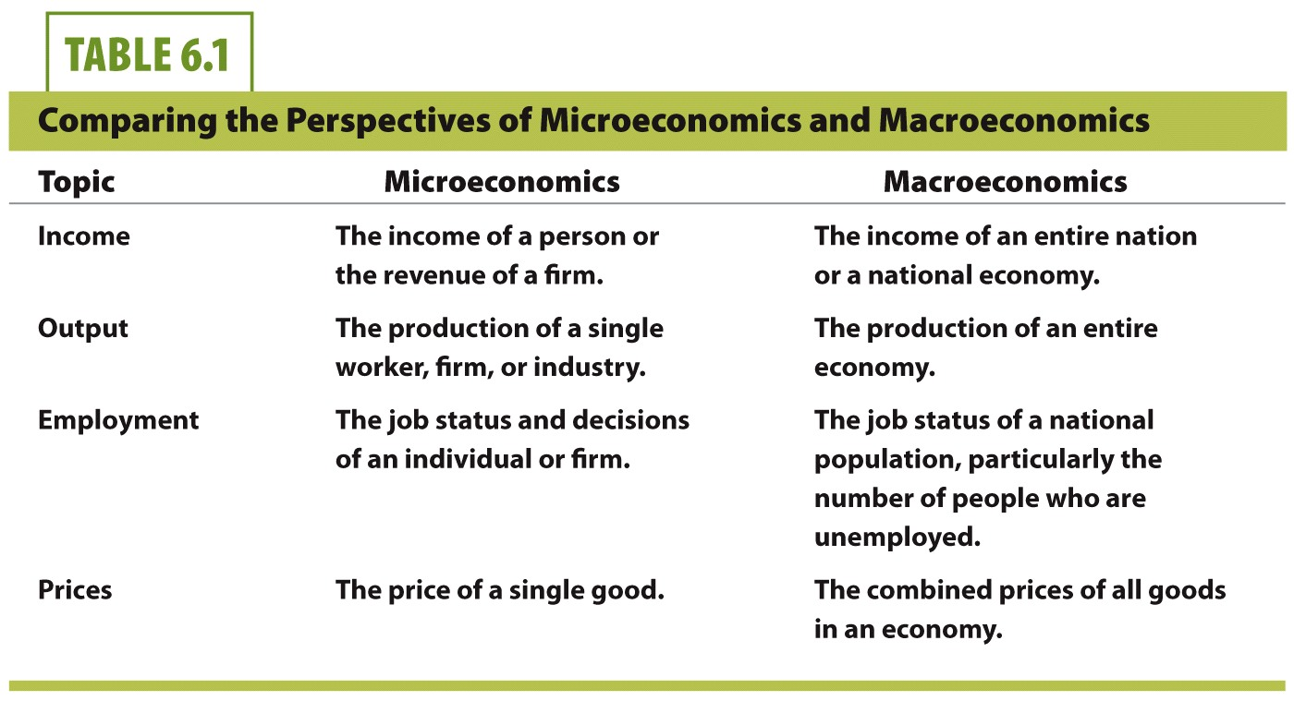

Slide 5
Misconception
Misconception: There is no reliable way to determine how well an entire economy is performing.
Economists disagree whether our economy is good or bad, whether it is getting better or worse.
However, there is an objective and reliable measure of macroeconomic performance—and it is Gross Domestic Product (GDP).
Notes:
We note the recurring heated debates about whether the economy is in recession. Look at the financial news right now. Almost certainly, you'll find economists claiming that both positive and negative conditions. So even economists don't seem to agree on whether the economy is headed in a positive direction or a negative direction. Given this, it seems like there is no good way of objectively measuring the performance of the macroeconomy.

Slide 6
Defining GDP
Gross Domestic Product
The market value of all final goods and services produced in a nation within a specific period of time.
Functions as a "barometer" for the economy.
Sum of output from all economic activity.
Output (sometimes Expenditure) becomes income.
Output (Expenditure)= GDP = Income
Notes:
Barometer for the economy? What does that mean?
When GDP goes up, it means national output and income are both higher. When GDP falls, this means the economy is producing less than before, and total national income is falling.

Slide 7
Production Equals Income
Output (sometimes Expenditure) and income are essentially the same.
Nations that produce a large amount of high-value output are relatively wealthy.
Nations that don't produce much high-value output are relatively poor.
Idea: the output you produce is sold, and you receive income for what you sell.
Notes:
Let's say you open a coffee shop in your college town. You buy resources for producing coffee, everything from coffee beans and espresso bars to workers and electricity. You use these resources to produce output like cappuccinos, espressos, and draft coffee. The first day you sell 600 different coffee drinks that average $4 each, so total output is worth $2,400. This is a measure of your firm's production or output on that day. But that $2,400 in sales is also a measure of income. The income is used to pay for your resources (the beans, bars, workers, and electricity) and to pay yourself. If you sell even more on the second day, the income generated increases. But if you sell less on the second day, income goes down.

Slide 8
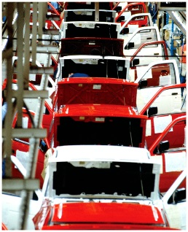
Looking Closely at How We Measure GDP
Why does GDP count the "market value"?
We can't just count quantities. Look at the year 2010.
United States produced 12 billion bushels of corn.
United States produced 8 million cars.
Just looking at quantity-produced numbers, corn seems more "important" to our GDP relative to cars.
Notes:
Be sure to emphasize the difference between million and billion on this slide.

Slide 9
Looking Closely at How We Measure GDP
 | Quantity | x | Price | = | Market Value
Corn | 12 billion bushels | x | $5 | = | $60 billion
Cars | 8 million vehicles | x | $30,000 | = | $240 billion
 |  |  |  |  | $300 billion

Slide 10
Looking Closely at How We Measure GDP
Why does GDP include both goods AND services?
Goods
Tangibles
Food, clothing, cars, houses
Services
Intangibles
Health care, entertainment, advice, travel, banking
The composition of our industries and economy has greatly changed over the last 50 years.

Slide 11
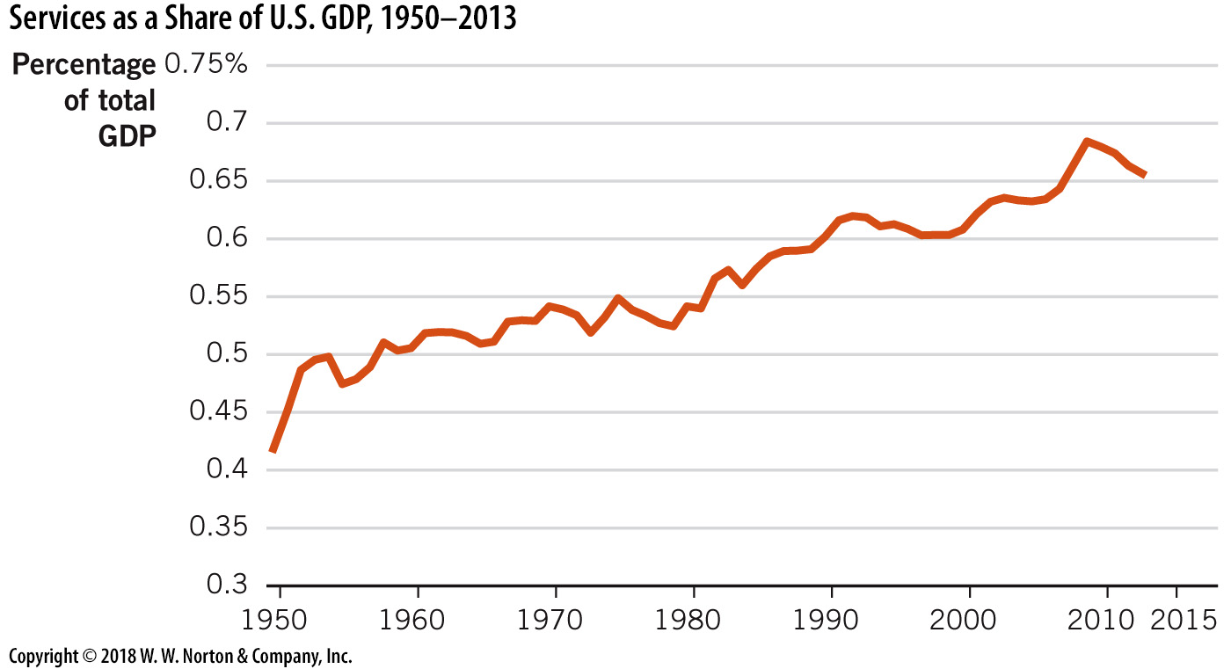
Services as a Share of U.S. GDP
Notes:
Image: Figure 19.6
Lecture notes:
Over the past 50 years, one big shift has been out of manufacturing (goods) and into services.
In the past, the dominant industries in the United States were goods such as automobiles, steel, and household goods.
Now, a majority of U.S. GDP is service output such as financial, transportation, retail, and technology services. Figure 19.6 above shows services as a share of U.S. GDP since 1960, which have grown from 50 percent in 1960 to about 70 percent in 2013.

Slide 12

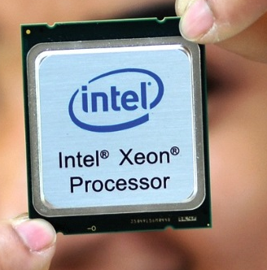
Intermediate vs. Final Goods
Final goods
Goods sold to the final users, or consumers.
To get an accurate GDP estimate and avoid double counting.
Finals goods are included in GDP.
Intermediate goods are not.
Notes:
If intermediate goods are counted too, they'd essentially be counted twice, as their value also increases the market value of the final good.
We don't want to count the good twice. Counting the milk once when it was sold to the coffee shop, and then counting it again as part of the value of the café mocha drink would count the milk twice and overestimate GDP.
Picture:
A microprocessor chip is an intermediate good used in computer and cell phones. The cell phone is the final good.

Slide 13
Intermediate Steps in Cell Phone Production
Steps | Value added during step | Price of completed steps
1. Outer case and keyboard | $ 5 | $ 5
2. Internal hardware | 10 | 15
3. Install operating system | 15 | 30
4. Connect to network | 49 | 79
5. Retail sale | 120 | 199
Sum total | $199 | $398
Notes:
The column on the right is a running total of the numbers on the left. The final price of the phone is $199. However, if we count all total values of all intermediate steps as GDP, we will overvalue the phone and say that it contributed $398 to GDP.
From Text:
It is possible to get an accurate measurement of GDP by taking the sale price of the final good or by taking the value added at each step along the way, but not both. That's double counting. So, we focus on final goods when determining GDP. You cannot get an accurate measure of GDP by summing up all of the sales made throughout the economy during the year since many of those sales will reflect the intermediate steps in the production process.

Slide 14
Looking Closely at How We Measure GDP
Why does the definition of GDP include the word "produced"?
Has to do with double-counting again.
Don't want to recount a good that was produced last year.
Examples:
Don't count a resold used car.
Stocks and bonds sold do not count, except for fees that pay for service.
Notes:
For instance, when a new car is produced, it adds to GDP in the year it is sold. However, used cars that are resold do not count in GDP since the used car was previously counted in GDP the year it was produced and sold for the first time. If we counted the used car when it was resold we would be counting that car as part of GDP twice, even though it was produced only once.

Slide 15
Included vs. Not Included in GDP
The cars produced in a Japanese-owned Toyota factory located in Kentucky in 2013 ➔ Is it included in US or Japan GDP of 2013?
The following items are not included in GDP:
Sales of intermediate products.
Sales of used goods.
Purely financial transactions.
Nonmarket activities.
Imported products and services.
Increases in the value of existing assets.
The underground economy.

Slide 16
Looking at GDP as Different Types of Expenditures
The Bureau of Economic Analysis (BEA) is the U.S. government agency that tallies GDP data, a task is called national income accounting.
GDP = C + I + G + NX
Net
Exports
Consumption
Investment
Government
Purchases

Slide 17
The Pieces of GDP in 2010, Billions of Dollars
Consumption (C) |  | $10,245.5 | 71%
Durable Goods | $1,085.5
Nondurable Goods | 2,301.5
Services | 6,858.5
Investment (I) |  | 1,795.1 | 12%
Business Fixed Investment | 1,728.2
Residential Construction | 338.1
Change in Business Inventories | 66.9
Government Purchases (G) |  | 3,002.8 | 21%
Federal | 1,222.8
State and Local | 1,780.0
Net Exports (NX) |  | -516.9 | -4%
Exports | 1,839.8
Imports | 2,356.7
Total GDP |  | $14,526.5 | 100%
Notes:
The table shows the composition of U.S. GDP in 2010. Total GDP was about 14.5 trillion dollars, not a small amount. How much is 14.5 trillion dollars? If you laid 14.5 trillion one-dollar bills side-by-side that would be enough to cover every U.S. highway, street, and county road more than twice! That is a LOT of money. Keep in mind, U.S. GDP is still almost three times larger than any other nation in the world.
You can see consumption is by far the largest component in GDP, followed by government spending and investment. Note that the value of net exports is negative, this occurs because the United States imports more foreign goods than it exports.

Slide 18


Consumption
Consumption
Final purchase of goods and services by households, with the exception of new housing. Generally, consumption is the largest component of GDP.
Durable goods
Goods consumed over a long period of time
Cars, appliances
Subject to cyclical fluctuations
Nondurable goods
Notes:
Cyclical fluctuations:
The economy can go through good times and bad times.
Good times for an individual: employed, certain income
Bad times for an individual: unemployed, uncertain or low income
You always have to buy food and perhaps medicine, even if times are bad. You might spend slightly less on food by purchasing lower quality (and lower priced) food items.
However, when times are bad, you'll put off buying a new refrigerator or new computer. You can probably still use your old one for a couple more months and be just fine.
Pictures:
Refrigerator is the durable good. The groceries you put in it are nondurable goods. You always have to buy groceries. But if you lose your job, you'll probably hold off on buying a new fridge.

Slide 19
Investment
Investment
Private spending on tools, factories, and equipment used to produce future output.
Also includes purchases by businesses that add to their inventories.
Inventories represent a stock of goods that firms can use to produce their product in the future. An increase in inventory allows the firm to make more and is an investment for the future.
New house purchases by consumers are counted as investment.
Investment is NOT "investing" in stocks and bonds.
Notes:
Only when a new piece of equipment is purchased or a structure is built do they count as investments. For example, when Pfizer builds a new factory for manufacturing a new drug, this is an investment. Similarly, when Walmart builds a new warehouse, that is also an investment.
Inventory example:
A large book printing company is confident that demand for books and magazines will be robust in the months ahead. They increase their supply of paper so they will not be caught short. Paper takes a long time to deliver from factories, and if they don't have the paper on hand when the order comes through, they lose the business as the book or magazine publisher keeps searching for a printer who has the paper on hand.

Slide 20

Government Purchases
Government Purchases
Government employee salaries
Government buildings and equipment produced
Public works projects, national defense, schools, post offices
Does NOT count
Transfer payments, such as welfare or social security
When households spend this income, it will enter GDP as part of consumption or investment.
Notes:
Transfer payments: payments that governments make to households.
Transfer payments act to increase household income since an increase in income does not, by itself, fit the expenditure definition of GDP, which measures how much is spent on goods and services.

Slide 21
Net Exports
Net Exports (NX)
Exports subtract imports.
If imports > exports → NX < 0 → Trade Deficit
If exports > imports → NX > 0 → Trade Surplus
NX represents a small fraction of total GDP.
Is it bad to be in a trade deficit?
Not necessarily
More imports means more goods and services for people in this country
Notes:
The reason we subtract imports is because they weren't produced here (even though they are used here).
We count exports because they are part of our domestic production.
Imports and Exports will be discussed more in Chapter 32.
We'll see that a trade deficit isn't necessarily "bad."

Slide 22



Shortcomings of GDP
The followings are not counted in GDP:
Nonmarket goods
Underground economy
The Quality of the Environment
Leisure time
Notes:
When the nonmarket segment of an economy is large, this can led to a dramatic undercounting of the annual output being produced. This is more prevalent in less-developed countries.
If transactions are not directly measurable (because the income is not reported), they are not included in official measures of GDP.
The Organization for Economic Cooperation and Development (OECD) has estimated that for developed countries, it is roughly 15% of GDP, in transitioning economies the percentage rises to between 21 and 30% of GDP, and in developing countries the underground economy can be as much as 45% of GDP.
The USA is widely believed to have one of the smallest shadow economies in the world with approximately 10 percent of GDP. In the United States, most citizens can earn more by legitimately participating in the economy than by engaging in illegal activities. A strong economy that creates jobs and opportunities for advancement helps to reduce the size of the underground economy.
Corruption is also less common, so participants in the economy are relatively free to transact with one another without bribes to authorities or organized crime. This is often not the case in many developing countries.
Since there is more to life than the goods and services we buy, using GDP to infer that both places are equally desirable would be inaccurate.
Picture:
Beautiful scenery, clean air, and clean water are generally things in which people place a positive value, but they are not counted in GDP.
Country B might use a production method that creates pollution—even though it produces the same as Country A, it won't be as desirable of a place to live.

Slide 23
Economics in Superbad
"Superbad"
Underground economy
Notes:
"Economics in the Media" Slide
Lecture notes:
The clip mentioned on the slide can be found in the Interactive Instructor's Guide. Access the direct link by clicking the icon in the PowerPoint above. (Link to Tip #212)
In this film, the main characters (three high school seniors) are trying to purchase liquor for a high school party in order to impress a girl. One of them, Fogell, participates in the underground economy by purchasing a fake ID. To his friends' chagrin, he chose the fake name "McLovin" for the ID.
You can use this clip to explain to your students that many purchases, such as fake identification cards, do not count toward U.S. GDP.
Alternatively, ask students read the article about the bust of a fake-identification ring at the University of Georgia several years ago. Fake IDs are a part of the underground economy that students can relate to. (Joe Johnson, "UGA Students Face Felony Charges Following Fake ID Probe," Online Athens, September 12, 2012, onlineathens.com)

Slide 24
Real GDP: Adjusting GDP for Price Changes
Real GDP
GDP measured with prices held constant over time.
Nominal GDP
GDP measured current prices.
Price level
An index to measure prices of goods and services in an economy.
Consumer Price Index (CPI) and GDP Deflator indicates price level.
The difference is the composition of goods they consider.
Notes:
"Real" just means we've accounted for inflation.

Slide 25
Real GDP: Adjusting GDP for Price Changes
CPI
Includes only a standard market basket of goods and services purchased by a typical urban family, not all final goods and services.
For calculation of Inflation, we have to use CPI.
We will come back to CPI later.
GDP deflator
A measure of the price level that includes prices of final goods and services in GDP.
Used to "deflate" out inflation from nominal GDP.
GDP deflator is a measure of price level used only for Real GDP calculation.
Don't worry about calculating GDP Deflator, it will be given to you.
Notes:
"Real" just means we've accounted for inflation.

Slide 26
U.S. Nominal GDP and Price Level, 2000–2010
Year | Nominal GDP (billions of dollars) | Price Level (GDP deflator)
2000 | $9,951.5 | 88.7
2001 | 10,286.2 | 90.7
2002 | 10,642.3 | 92.2
2003 | 11,142.2 | 94.1
2004 | 11,853.3 | 96.8
2005 | 12,623.0 | 100.0
2006 | 13,377.2 | 103.2
2007 | 14,028.7 | 106.2
2008 | 14,291.5 | 108.6
2009 | 13,939.0 | 109.7
2010 | 14,526.5 | 111.0
Source: BEA
2005 is the base year,
so Price level for 2005 is 100.
Notes:
To compute real GDP, we extract the current prices of goods and services and then put in prices from a common year, or "base year."
In this table, the base year is 2005. Thus, we will measure the output in all years, and then find GDP using the price level for the year 2005. This will allow us to find only differences in REAL output, as opposed to GDP differences caused by just price changes.

Slide 27
U.S. Nominal and Real GDP
Which year is the base year here?
Can you tell by only looking this plot?
Notes:
Note the difference between Real and Nominal GDP. This difference is due to inflation.
Example:
USA produces 10 million apples in 2010. The price is $1 per apple. GDP from apples is $10 million.
USA produces 11 million apples in 2011. The price is $1.10 per apple, and this price increase is mainly due to inflation. Even though production remained the same, the nominal GDP (using 2011 prices) is $11 million dollars. If we examine 2011 output using 2010 prices, Real GDP in both years would be equal.

Slide 28
Finding Real GDP
Filter out the current prices from the nominal GDP data.
Divide nominal GDP by the price level for the year the GDP was produced.
Put in the constant prices from the base year.
Multiply by the price level (100) from base year 2005.
Notes:
Why do we divide by the price level?
We do this to adjust for inflation. If we want to compare REAL 2010 GDP to 2005 GDP, we must measure only the increase in GDP due to production, and NOT due to price increases (inflation).

Slide 29
Example
Find Real GDP for 2010.
"2010 GDP in 2005 prices"
Fill in equation, use t = 2010 numbers from table.
Notes:
Once again, we are finding 2010 Real GDP in terms of 2005 prices. We have adjusted for inflation.

Slide 30
Growth Rates
Growth rates
Tell us how fast our economy is growing.
Can be calculated using a percent change formula.
A negative growth rate means the economy is contracting (recession).
Caveat: We care only Real GDP Growth Rate since Nominal GDP Growth Rate can be misleading due to increase or decrease in price level.
Notes:
Important note to tell students!!
The 100 we are multiplying by is NOT the same 100 from before. The 100 here is used to give us a percentage instead of a decimal.
In other words, 0.54 is 54%. We take 0.54 times 100.
Percent change formula = "new minus old all divided by old". This means we need two values to plug into the equation.

Slide 31
Growth Rates
Using the numbers from the table again.

Slide 32
Growth Rates
Price level growth rate
The same as the GDP deflator growth rate.
Another useful evaluative formula
Notes:
Bottom equation:
Nominal GDP is the product of the price level and real GDP. When either of these changes, it affects nominal GDP.
The growth rate of nominal GDP is the sum of the growth rates of these two pieces.
This equation is a simple way of dissecting the growth of GDP into its respective parts. For example, since we know nominal GDP grew by 4.2% in 2010, and the price level grew by 1.2%, the remaining nominal GDP growth of 3% is due to growth in real GDP.

Slide 33
Conclusion
Determining how much output is produced in the economy gives a benchmark from which to examine economic growth and fluctuations in economic activity.
Measuring GDP allows us to examine economic output across countries.

Slide 34
Practice What You Know
Gross domestic product (GDP) also measures
A nation's exports.
A nation's debt.
A nation's income.
A nation's consumption.
Notes:
Correct answer: C
Output = GDP = Income

Slide 35
Practice What You Know
Why does not GDP count expenditures on intermediate goods?
To make GDP calculations easier
Because intermediate goods are used by firms instead of consumers
To avoid double counting
Intermediate goods have no market value
Notes:
Correct answer: C
If we count intermediate goods, and then count final goods (which are created from intermediate goods), we would be double counting. We don't count the cheese, pepperoni, sauce, and also the pizza. We just count the final pizza.

Slide 36
Practice What You Know
What is the biggest component of GDP?
Consumption [C]
Investment [I]
Government Purchases [G]
Net Exports [NX]
Notes:
Correct answer: A
Consumption is much bigger than the other components at $10 trillion each year. Net exports is actually negative since we import more than we export.

Slide 37
Practice What You Know
Which of the following would not be included in GDP?
Bob hires a construction company to build his home
Michael pays the neighbor kid to mow his yard
Alex buys some cheese and dough to bake a pizza at home
Elyse buys some shoes
Notes:
Correct answer: B
You could probably imagine that this is a cash transaction. Even if Michael pays the kid with a check, it's not going to be taxed or reported to the government.

Slide 38
Practice What You Know
How is real GDP different from nominal GDP?
Real GDP is adjusted for inflation, and nominal GDP is just measured in current prices.
Real GDP includes goods and services, and nominal GDP only includes goods.
Real GDP averages income over time, and nominal GDP is just for this year.
Notes:
Correct answer: A
"Real" means inflation-adjusted. Real GDP is found by adjusting nominal GDP for inflation.

Slide 39
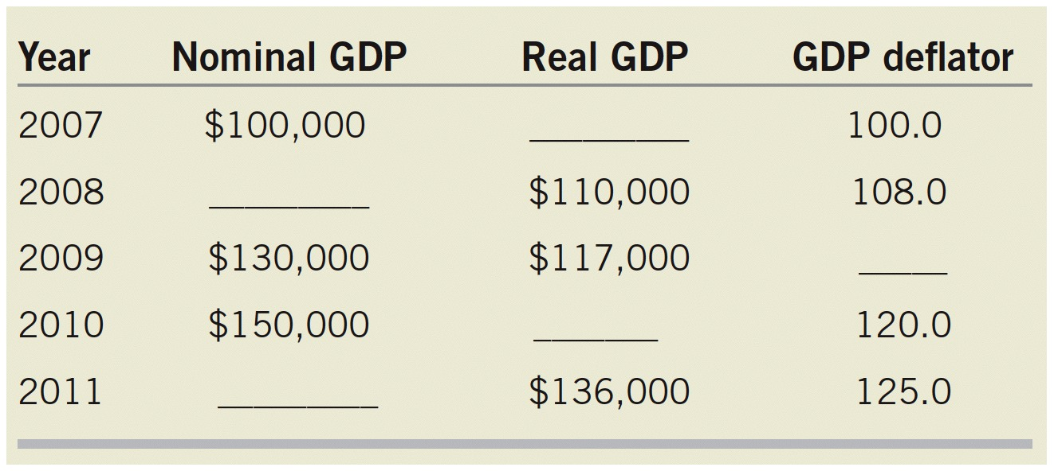
Practice What You Know
Fill the blanks.

Slide 40
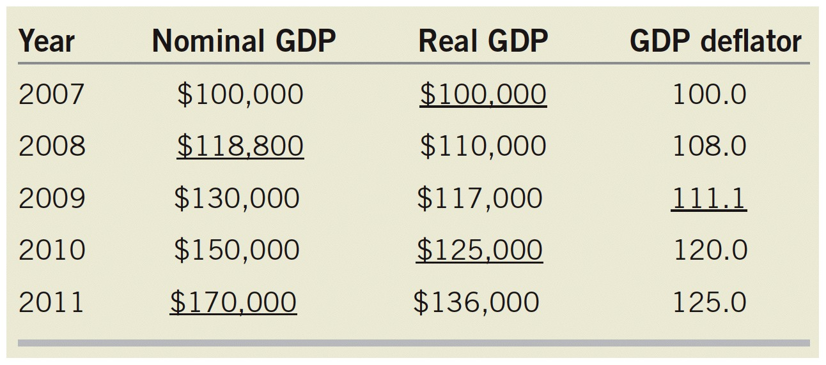
Practice What You Know

Slide 41
Sources
"Principles of Economics with Smartwork Access (ISBN: 978-0-26314-5), 1st Edition, 2013" by Mateer and Coppock
"Economics: Custom Edition for NCSU (ISBN: 9781937435202" by David Hyman

